Slide 1
Regression Analysis
Jaya Sil

Slide 2
Introduction
Regression analysis is a form of predictive modelling technique which investigates the relationship between a dependent and independent variable.
“Using the relationship between variables to find the best fit line or the regression equation that can be used to make predictions”.
There are many types of regressions such as ‘Linear Regression’, ‘Polynomial Regression’, ‘Logistic regression’.

Slide 3
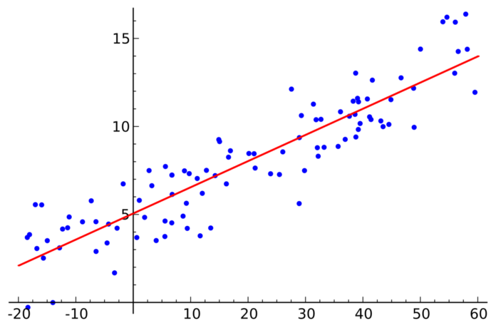
Introduction

Slide 4
Linear regression
Linear regression is a linear model, e.g. a model that assumes a linear relationship between the input variables (x) and the single output variable (y).
More specifically, that y can be calculated from a linear combination of the input variables (x).
One variable is considered to be an explanatory variable (x), and the other is considered to be a dependent variable (y).
y = c + mx
C = constant m = slope
The output (y) varies linearly based upon the input (x).

Slide 5
Linear Regression
How much value of x has impact on y is determined by “m”.
‘c’ is the constant (value of y when x is zero).
Before attempting to fit a linear model to the observed data, first determine whether or not there is a relationship between the variables of interest.
A scatterplot can be a helpful tool in determining the strength of the relationship between two variables.
If the scatterplot does not indicate any increasing or decreasing trends, then fitting a linear regression model to the data probably will not provide a useful model.

Slide 6
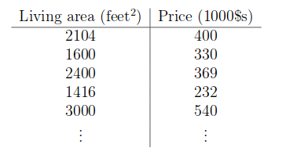
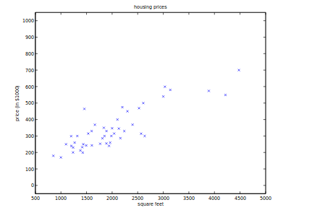
Scatter Plot
Scatter plot

Slide 7
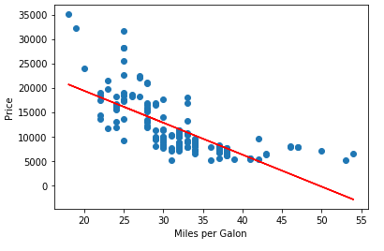
Linear Relationship between two Variables
How to find this straight line?

Slide 8
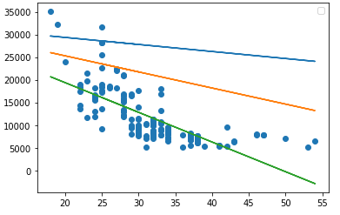
How to find which line is the best?
price = c + m * mpg = f (c, m, mpg) ; f is the model
Different values of c and m generate different straight lines.
Choose the best values of c and m to get the best fitting line.
The best line is the one that better fits the data points.
If we are able to figure out the values of c and m then we can predict the value of y for any new x.

Slide 9
Least-squares
A linear regression line has an equation Y = c + mX, where X is the explanatory variable and Y is the dependent variable.
The slope of the line is m (w₁), and c (w₀) is the intercept, usually referred as weights.
The most common method for fitting a regression line is the method of least-squares.
This method calculates the best-fitting line for the observed data by minimizing the sum of the squares of the vertical deviations from each data point to the line.
If a point lies on the fitted line exactly, then its vertical deviation is 0.

Slide 10
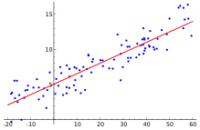
Best fit line
100% perfect value of c and m is not possible.
But what we can do it to find the best fit line.
We need a mechanism to move this line iteratively and slowly towards the place where it best fits the sample data.
Figure out a line whose distances from each dot in the graph is optimal/minimal. This would mean ‘best fit line.

Slide 11
Best fit line
To find if it is best fit line or not
If it is not best fit line then move it towards the best fit line. It means we will have to change the value of c and m.
Our challenge today is to determine the value of m and c, such that the line corresponding to those values is the best fitting line or gives the minimum error.
We will use combination of gradient descent with least square method to achieve these objectives. These are explained below.

Slide 12
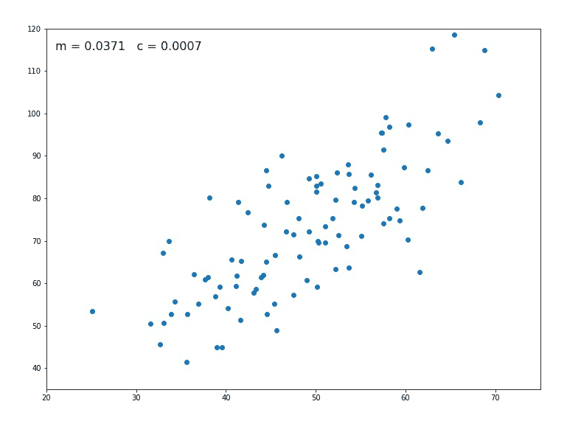

Slide 13
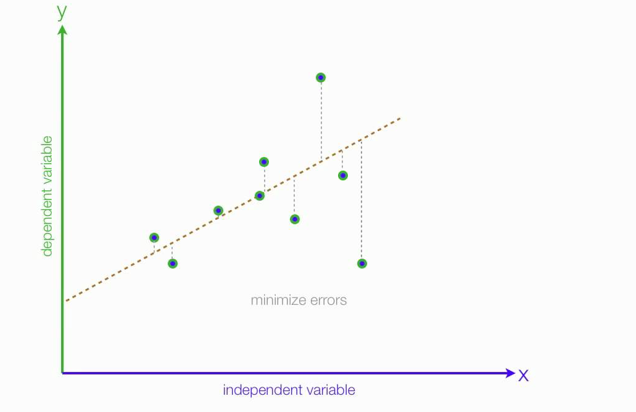
The Loss/Cost Function
The loss is the error in our predicted value of m and c.
Our goal is to minimize this error to obtain the most accurate value of m and c.

Slide 14

Mean Squared Error function
yᵢ is the actual value and ȳᵢ is the predicted value.
Mean Squared Error function is used to calculate the loss.
There are three steps in this function:
Find the difference between the actual y and predicted y value(y = mx + c), for a given x.
Square this difference.
Find the mean of the squares for every value in X.

Slide 15
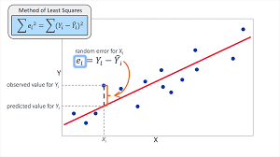
Cost or Loss function L(w): Least square

Slide 16

Error
Lets substitute the value of ȳᵢ:
we have defined the loss function, next part — minimizing it and finding m and c.

Slide 17


Error
To check the error we have to calculate the sum of squared error and tune the parameters to try to reduce the error.
Error = Σ (actual output — predicted output)²
Key: 1. Y(predicted) is also called the hypothesis function. 2. J(θ) is the cost function which can also be called the error function. Our main goal is to minimize the value of the cost. 3. y^{(i)} is the predicted output. 4. h_{θ}(x^{(i)} ) is called the hypothesis function which is basically the Y(predicted) value.

Slide 18
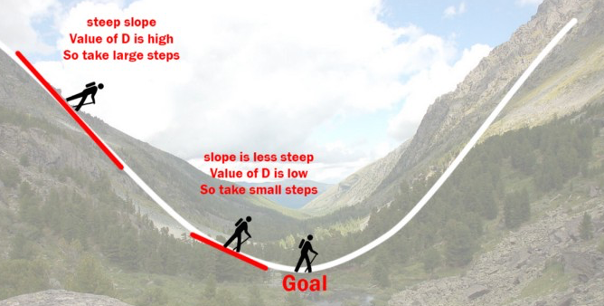
The Gradient Descent Algorithm
Gradient descent is an iterative optimization algorithm to find the minimum of a function, i.e. Loss Function.

Slide 19
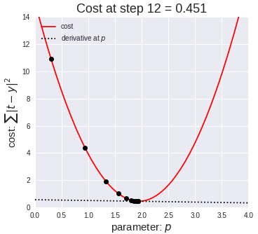
Gradient Descent
Reduce the error value using Gradient Descent.
The goal of Gradient descent is to minimize the cost value. i.e. min J(θo, θ₁)
Choosing a perfect learning rate is a very
important task as it depends on
how large of a step we take downhill
during each iteration.
If we take too large of a step, we may step
over the minimum.
However, if we take small steps, it will
require many iterations to arrive at the minimum.

Slide 20
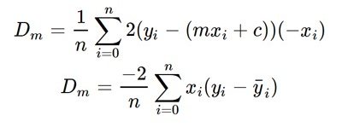
Gradient descent to find m and c
Initially let m = 0 and c = 0.
Let L be our learning rate, controls how much the value of m changes with each step.
L could be a small value like 0.0001 for good accuracy.
Calculate the partial derivative of the loss function with respect to m.

Slide 21

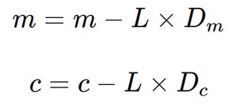
Partial derivative with respect to c:Dc
Now we update the current value of m and c :
Repeat the procedure until we obtain very small error or Loss function value. Corresponding m and c are optimum value.

Slide 22
Prediction
Now the new value of m that we calculate will be his next position, and L×D will be the size of the steps he will take.
When the slope is more steep (D is more) he takes longer steps and when it is less steep (D is less), he takes smaller steps.
Finally he arrives at the bottom of the valley which corresponds to our loss = 0.
Now with the optimum value of m and c our model is ready to make predictions !

Slide 23
Find the choice of w that minimizes L(w).
The optimization procedure finds the best choice of w
The gradient ∇_{w}L(w) of a differentiable function L is a vector that points in the direction of steepest increase as a function of w
It is easy to see how an optimization algorithm could use this to make a small change to w that decreases (or increase) L(w).

Slide 24
Optimization Method
Compute the gradient:
∂L(w)/∂w₁
∇_{w}L(w)= ∂L(w)/∂w₂
⋮
∂L(w)/∂w_{n}
Differentiating the cost function L(w) with respect to a particular parameter w_{j} :
∂L(w)/∂w_{j} = ∑_{i}x^{(i)}_{j}(h_{w}(x^{(i)})−y^{(i)})

Slide 25
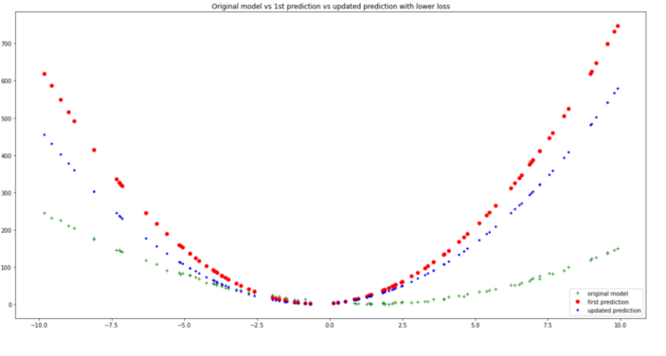
Epochs
Perform gradient descent iteratively over a number of epochs (cycles or iterations.)
With every epoch an improvement is observed in the form of lowered loss, and better model-fitting to the original data.

Slide 26
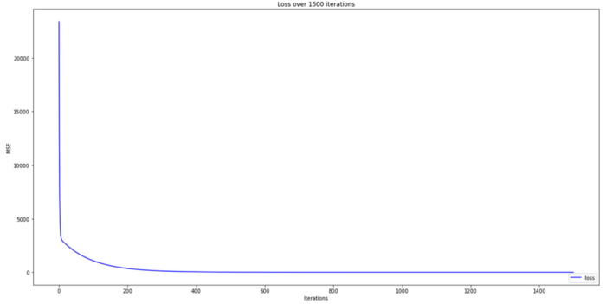
Termination
There was no major improvement in loss after about 400 epochs definitely no need for 1500 epochs.
An alternative strategy would be to add some kind of condition to the training step that stops training when a certain minimum loss threshold has been reached.
This would prevent excessive training and potential over-fitting for the model.

Slide 27
Under-Fitting
Our data is correlated, but if the relationship doesn’t look linear.
A polynomial regression on the data to fit using a polynomial equation.
The straight line is unable to capture the patterns in
the data, an example of under-fitting.
To overcome under-fitting, we need to increase the complexity of the model.
To generate a higher order equation we can add powers of the original features as new features.

Slide 28
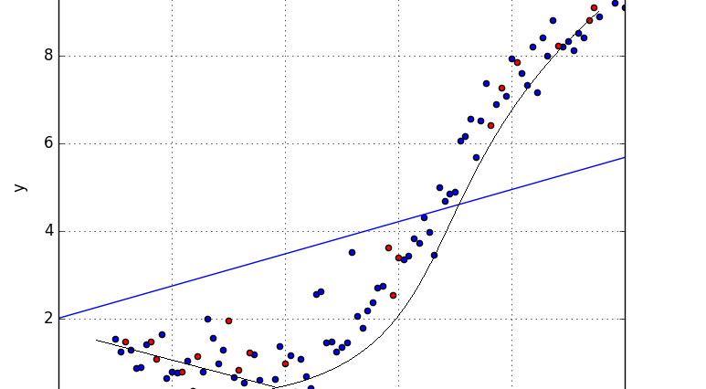
Underfitting

Slide 29
Polynomial Linear Regression
This is still considered to be linear model as the coefficients/weights associated with the features are still linear where x² is a feature.
However, the curve that we are fitting is quadratic in nature.
Fit a polynomial line so that we can achieve a minimum error or minimum cost function.
Y = θo + θ₁X + θ₂X² + … + θmXᵐ + residual error

Slide 30
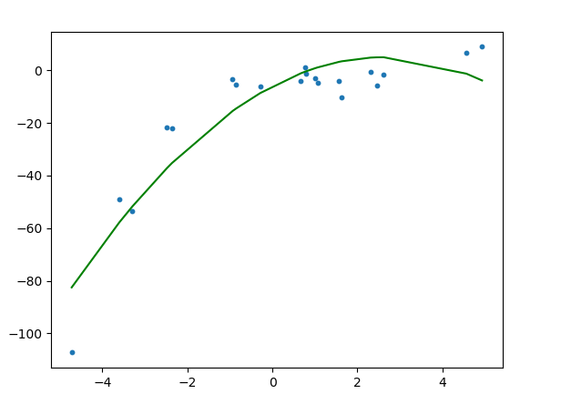
Polynomial Linear Regression

Slide 31

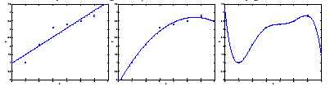
Predicting of y from x ∈ ℜ
y = w₀ + w₁x
y = w₀ + w₁x + w₂x²
Data points do not lie on the straight line
Added an extra feature x². Slightly better fit the data
More features make better fitting
But higher order polynomial or more features used for modeling not a good predictor.
Selection of features are important for good prediction

Slide 32
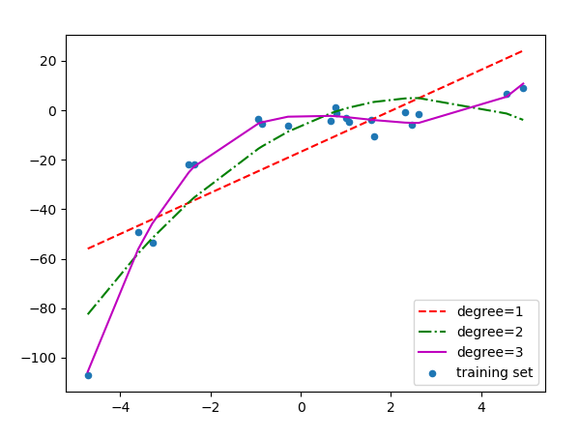
Polynomial Linear Regression

Slide 33
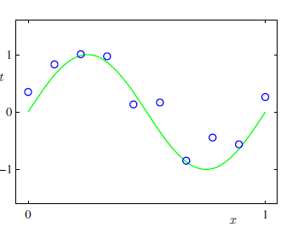
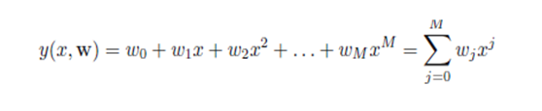

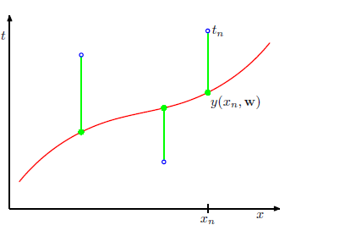
Modeling of function sin(2πx)
Error function is a nonnegative quantity that would be zero if, and only if, the function y(x,w) passes exactly through each data point.

Slide 34
Error Function
We can solve the curve fitting problem by choosing the value of w for which E(w) is as small as possible.
Because the error function is a quadratic function of the coefficients w, the derivatives with respect to the coefficients will be linear in the elements of w.
So the minimization of the error function has a unique solution, denoted by w*.

Slide 35
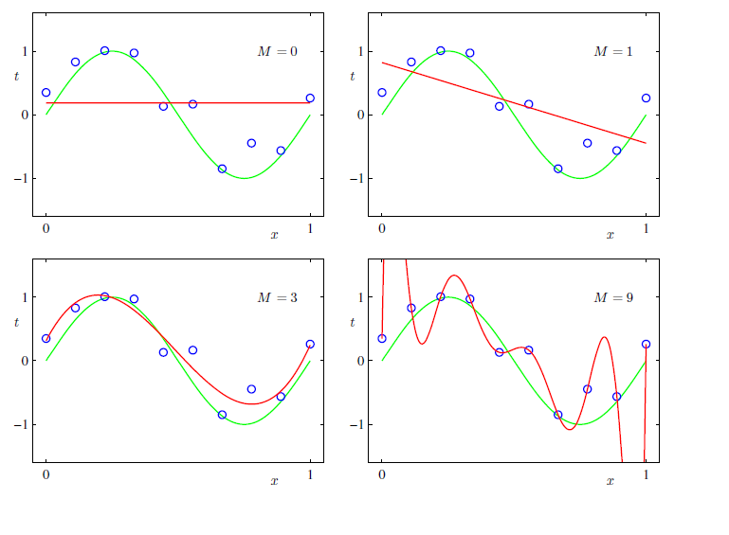
The problem of choosing the order M of the polynomial, Important concept i.e. model selection.

Slide 36
Model Selection
The constant (M = 0) and first order (M = 1) polynomials poor fit the training data and consequently poor representations of the function sin(2πx).
The third order (M = 3) polynomial best fit to the function sin(2πx) but not all the training data.
Higher order polynomial (M = 9), obtain an excellent fit to the training data, and E(w) = 0.
However, the fitted curve oscillates wildly and gives a very poor representation of the function sin(2πx).
This behaviour is known as over-fitting.

Slide 37
Root Mean Square Error =
The goal is to achieve good generalization by making accurate predictions for new data.
Generalization performance on M is measured by the test data.
For each choice of M, we evaluate E(w*) for the training data, and also evaluate E(w*) for the test data set.
It is sometimes more convenient to use the root-mean-square in which the division by N allows us to compare different sizes of data sets on an equal scale.

Slide 38
Coefficients w*
As M increases, the magnitude of the coefficients become larger.
For M = 9 polynomial, the coefficients are finely tuned to the data with large positive and negative values so that the corresponding polynomial function matches each of the data points exactly.
Between the data points (particularly near the ends of the range) the function exhibits the large oscillations.

Slide 39
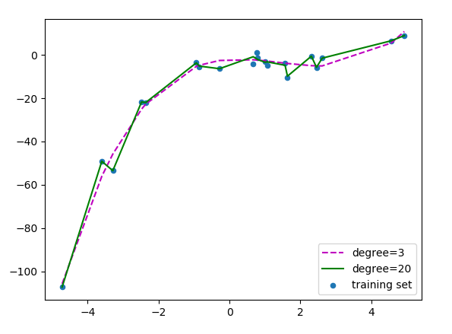
Over-fitting
For degree=20, the model is also capturing the noise in the data. This is an example of over-fitting. Even though this model passes through most of the data, it will fail to generalize on unseen data.

Slide 40
Generalization and Over-fitting
Best model is one doing accurate prediction for all data.
Such model can generalise other than the training instances.
Selection of Model is challenging.
More complex model makes closer training data points up to a certain limit, beyond which the prediction accuracy fall.
If the model does not have the generalization capacity the problem is called overfitting.

Slide 41
Why Overfitting
One of the major aspects of training the model is avoiding overfitting.
Overfitting happens when a model learns the detail and noise in the training data to the extent that it negatively impacts the performance of the model on new data due to detailing of large training data.
The model or Machine learning algorithm will have a low accuracy if it is overfitted.
Overfitting occurs due to complexity which have more freedom in building the model based on the dataset and therefore they can really build unrealistic models.

Slide 42
Bias
Bias refers to how correct the model is.
A very simple model that makes a lot of mistakes is said to have high bias.
A very complicated model that does well on its training data is said to have low bias.
The idea of having bias about the model giving importance to some of the features in order to generalize better for the larger dataset with various other features.
Bias in machine learning is a type of error in which certain features of a dataset are more heavily weighted.

Slide 43
Variance
Variance which describes how much a prediction could potentially vary if one of the predictors changes slightly.
Simplicity of the model makes its predictions change slowly with predictor value, so it has low variance, high bias.
On the other hand, complicated, low bias model likely fits the training data very well and so predictions vary wildly even predictor values change slightly.
This means this model has high variance, and it will not generalize to new/unseen data well.

Slide 44
How do we choose an optimal model?
To prevent over-fitting, we can add more training samples so that the algorithm doesn’t learn the noise in the system and can become more generalized.
The Bias vs Variance trade-off
Bias refers to the error due to the model’s simplistic assumptions in fitting the data. A high bias means that the model is unable to capture the patterns in the data and this results in under-fitting.
Variance refers to the error due to the complex model trying to fit the data. High variance means the model passes through most of the data points and it results in over-fitting the data.

Slide 45
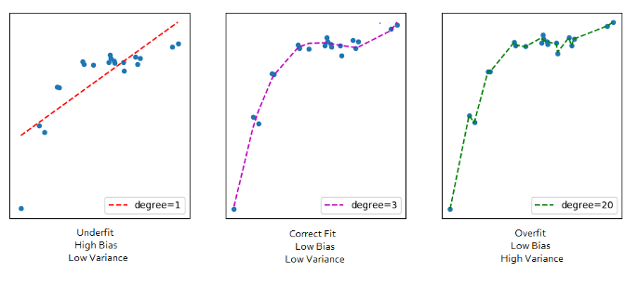
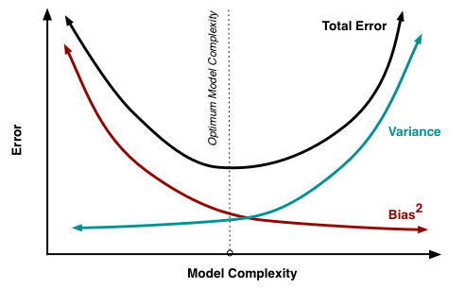
The model complexity increases, the bias decreases and the variance increases and vice-versa.
Ideally, a machine learning model should have low variance and low bias.
But practically it’s impossible to have both. Therefore to achieve a good model that performs well both on the train and unseen data, a trade-off is made.

